Slide 1

BMS INSTITUTE OF TECHNOLOGY AND MANAGEMENT
Avalahalli Post, Yelahanka, Bengaluru-560064
DEPARTMENT OF MCA
Seminar Guide:
Prof.Dwarakanath G.V
Assistant Professor
Presented by Rupak Dutta and Shadab Ansari

Slide 2
Smart Door Lock using Face Recognition

Slide 3
Table of Contents
Abstract
Introduction
Block Diagram
Components to be used
Methodology

Slide 4
Abstract
Security is at most concern for anyone nowadays, whether it's data security or security of their own home. With the advancement of technology and the increasing use of IoT, digital door locks have become very common these days. Digital lock doesn’t require any physical key but it uses RFID, fingerprint, Face ID, pin, passwords, etc. to control the door lock.
Face Recognition technology has improved drastically in the past decade and now it is primarily used for surveillance and security purposes.Face Recognition is a more complex task that needs to classify if the human face detected matches the faces the software has already seen. It is essentially an object-classification-cum-object-detection task for human faces

Slide 5
Introduction
Face recognition system is broadly used for human identification because of its capacity to measure facial points and recognize the identity in an unobtrusive way. The application of face recognition systems can be applied to surveillance at home, workplaces, and campuses,accordingly.
In this project we will build Face ID controlled Digital Door lock system using ESP32-CAM.

Slide 6
Block Diagram
ESP Server
ESP32-CAM
Actuator
FTDI Board
12 V Supply
Relay

Slide 7
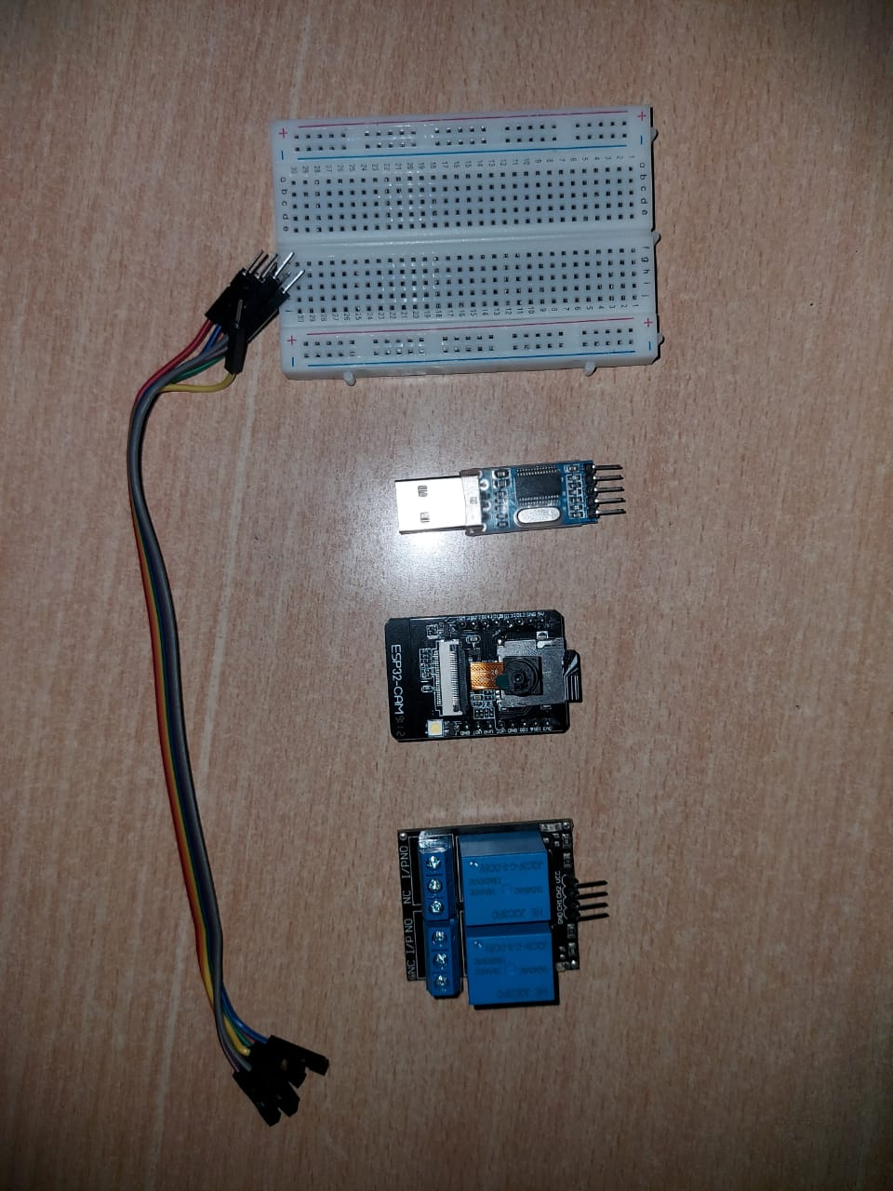
Components to be used
ESP32 CAM(Microcontroller +Camera)
FTDI Board(for powering up esp32 and feeding data into it)
Relay module
Servo motor
Jumper Wires
Buzzer
Leds

Slide 8
Methodology
The ESP-32 Cam scans the user’s face.
The scanned face is then checked with the stored images from the microSD card.
If face matches the image,it then send an ON signal to the relay.
The relay then sends signal to the Servo motor lock which unlocks it

Slide 9
Thank You

